Slide 1

Octet BLI Technology and Application Overview
Bob Dass (FAS, Mid-Atlantic)
Mahasti Alavi (Sales Manager, Mid-Atlantic)
Notes:
Hello everyone
I’m going to give a brief overview of Product marketing activities for the Allegro product range
NEXT SLIDE

Slide 2
AGENDA
AGENDA:
Octet and BLI Introduction and Over view - 30 mins
2. Popular Applications/ Assays using Octet - 10 Mins
3. Q and A from the slides presented 15 mins
4. Specific questions:
Yiran Wang, Ph.D
Buenafe T. Arachea, Ph.D.
Iga Kucharska, Ph.D

Slide 3
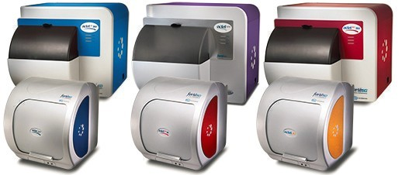
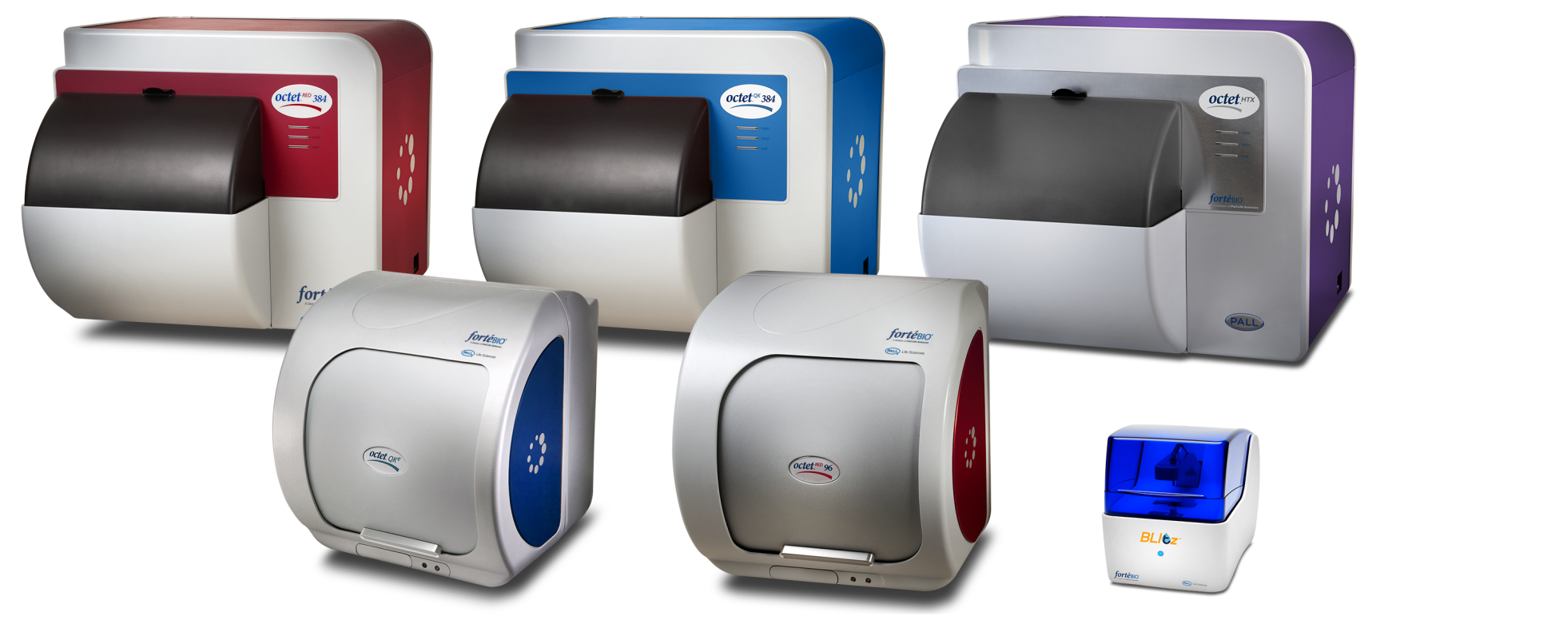
ForteBio BLI Systems: Label-Free Protein Analysis
Definitive Kinetic Analysis
Fast Protein Quantitation
Analyze Unpurified Samples
Straightforward Operation

Slide 4
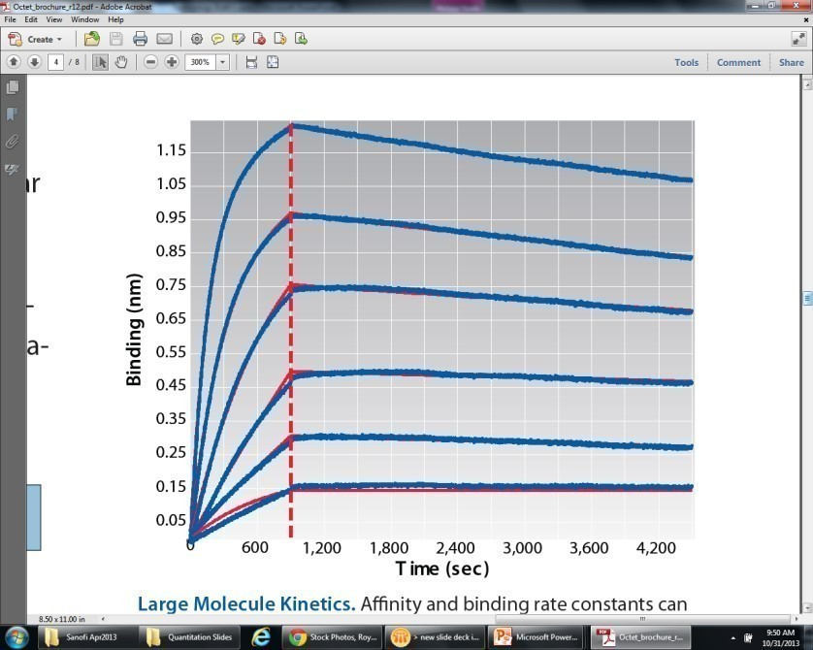
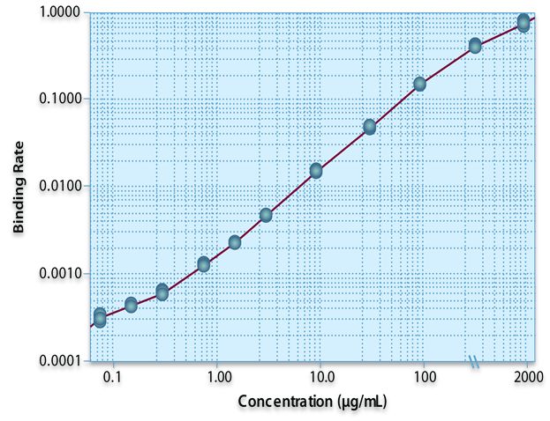
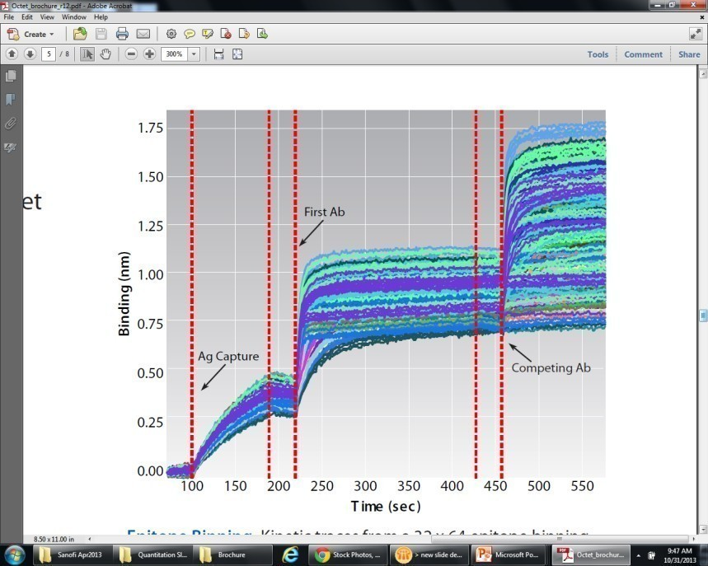
What ForteBio BLI Systems Provide
Kinetics
k_{a}, k_{d}, K_{D}
Proteins, Abs
Peptides, oligos
Small molecules
Quantitation
Direct, 1-step
Sandwich
ELISA
mg/mL – pg/mL
Specificity
Function testing
Epitope binning
Rank ordering
Isotyping
Large menu of biosensors enables diverse applications
Notes:
What information does one gain from the Octet? The range is quite versatile – from kinetics data – information such as Ka, Kd and affinity constants for a wide range of molecules to Quantitation consisting of simple single step quantation assay up to more complex multi step assays such as Elisa (which I’ll get into more detail in a later slide). Another very valuable way the Octet can help you with your work is to gain specificity information about your molecules. By that I mean such things as functionality testing, epitope binning, ranking order, isotyping, competition assay and the list goes on.

Slide 5
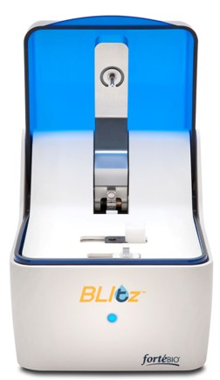
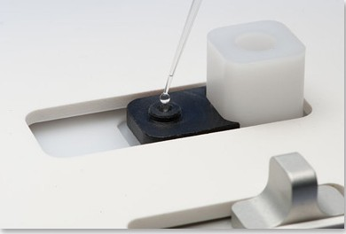
ForteBio BLI Systems: Blitz
Needs only 4 µL of sample in drop holder.
Can use 250 µL in tube holder.

Slide 6
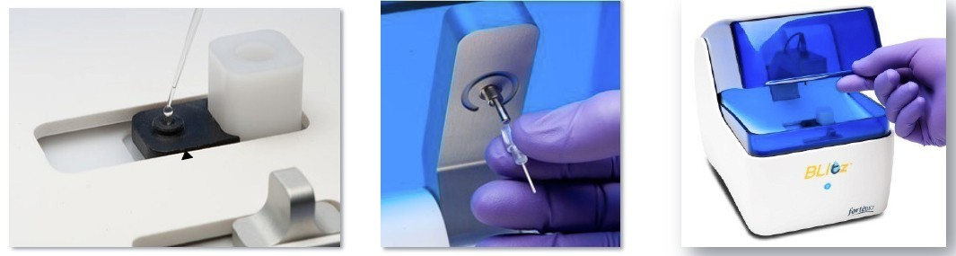
Data Collection on the Blitz
All steps are prompted by the software

Slide 7
Stable Conditions Make for Stable Measurements
Do not place the instrument in direct sunlight
Allow the system at least 30 minutes to warm up after switching on the power
Bring all reagents to room temperature before analyzing

Slide 8
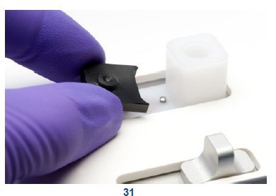
High Sensitivity Measurements Require Thorough Cleaning
Insufficient cleaning of the drop holder can give false signals
Rinse with buffer at least 3x, using a kimwipe or supplied swab
Use 0.5N HCL to periodically clean the drop holder
Multiple users may want their own drop holders
Do not allow samples to dry on the drop holder

Slide 9
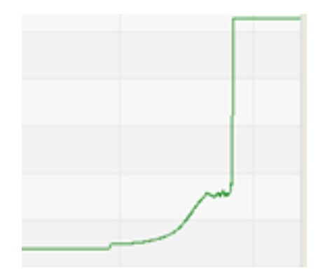
Limit Sample Evaporation for Better Results
Drop Holder measurements are limited to 5 minutes
Microfuge tube measurements are limited to 15 minutes

Slide 10
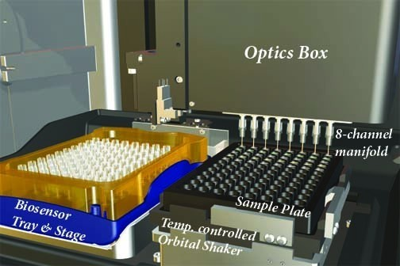
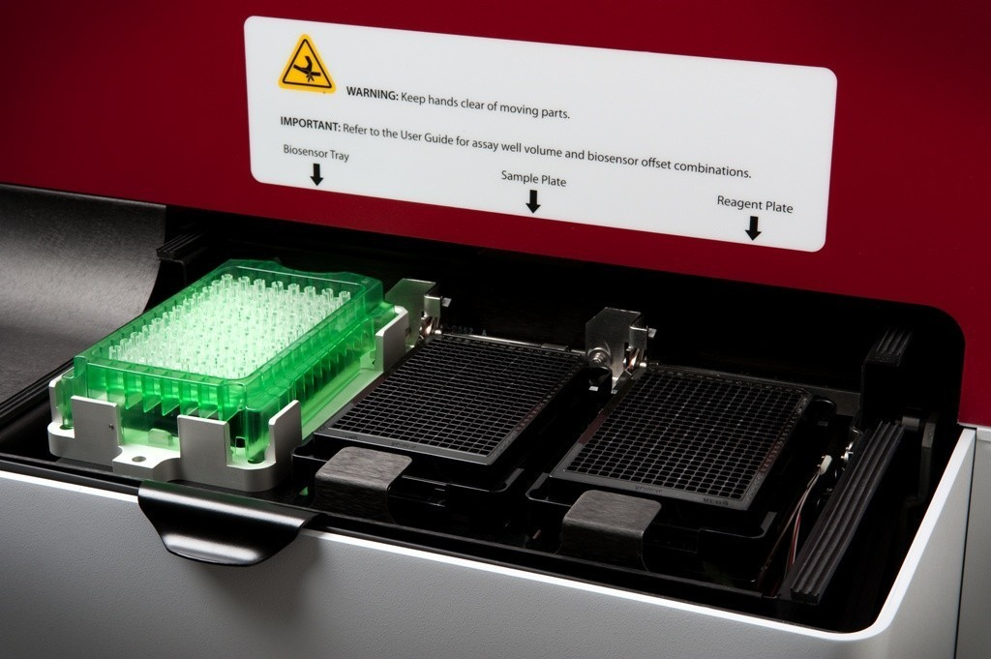

ForteBio BLI Systems: Octet
Octet 96
Octet 384/HTX
One biosensor tray
One 96-well sample/reagent plate
8 simultaneous readings
One biosensor tray
Two 96-well or 384-well sample/reagent plates
16 simultaneous readings (Octet 384)
8, 16, 32, 48, or 96 simultaneous readings (Octet HTX)

Slide 11
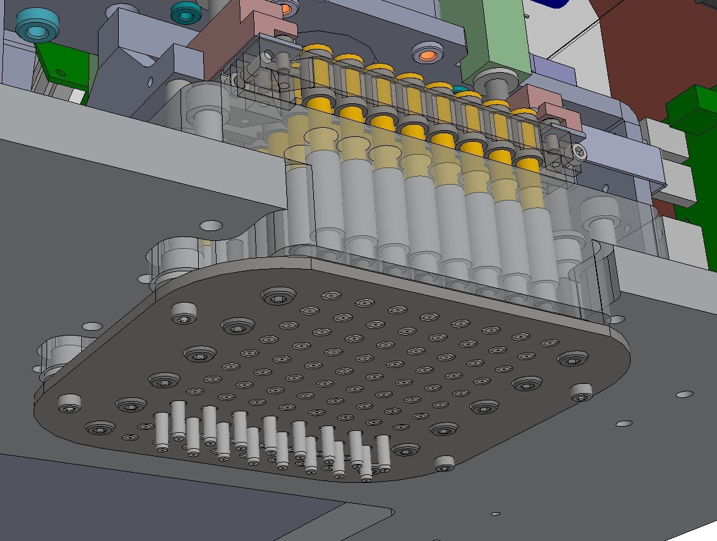
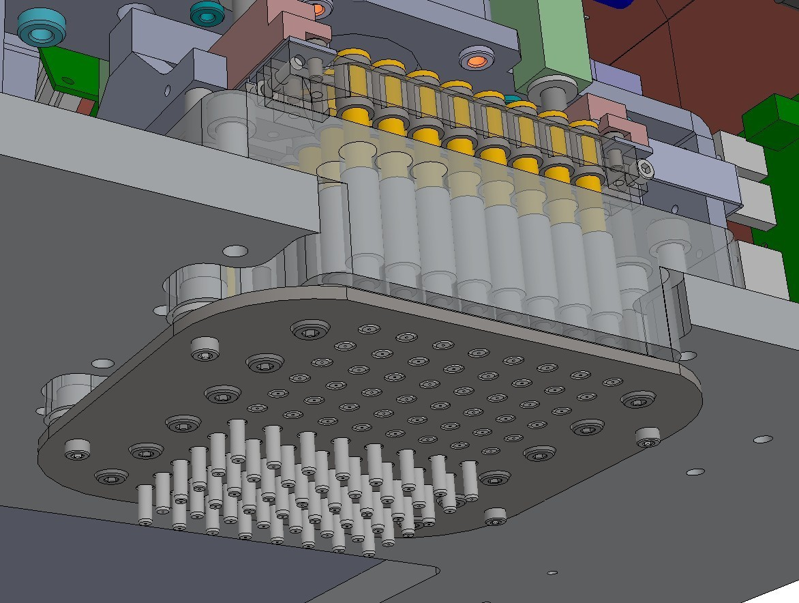
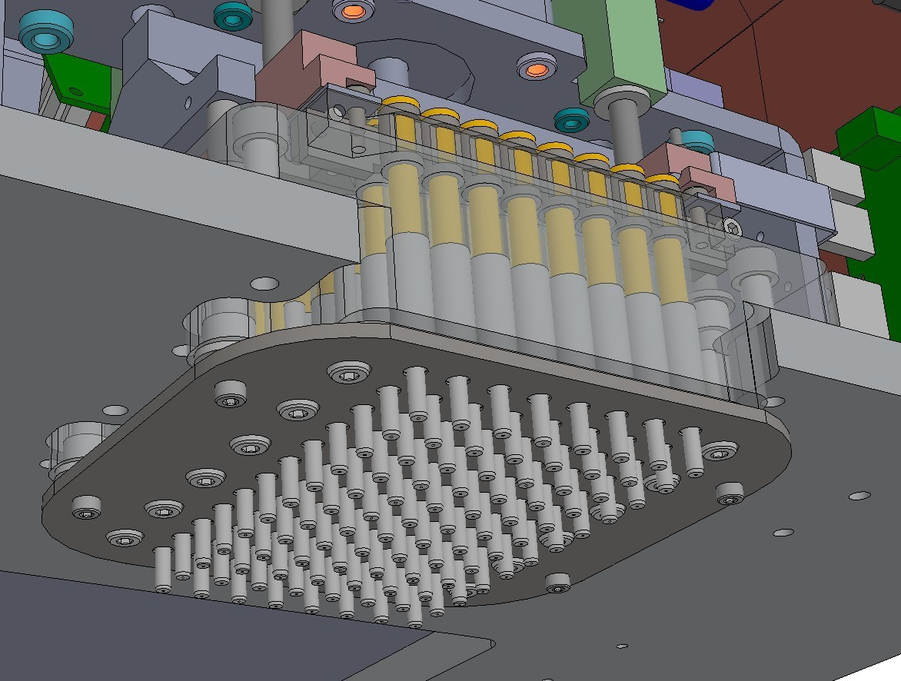
HTX Breakthrough Technology: User-Selectable Read Head
8 or 16 sensors – RED96/384 sensitivity
32 or 48 sensors – QK384 sensitivity
96 sensor – QK384 sensitivity
Notes:
What sets the HTX apart?
“You don’t have to choose anymore” We can do it all, high resolution and accelerated workflow
Note. Competitors: Biacore, Proteon, Wasatch, etc. focus on either high resolution kinetics/affinity or throughput. Hydra provides both.

Slide 12
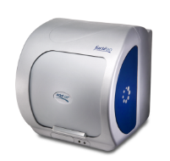
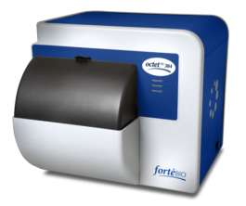
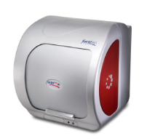
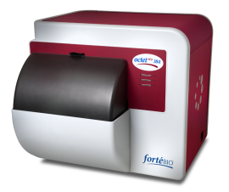
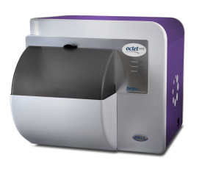
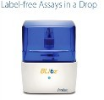
 | BLItz | Octet QKe | Octet QK384 | Octet RED96 | Octet RED384 | Octet HTX
Molecular Weight Range | >10,000 D | > 5000 D | > 5000 D | > 150 D | > 150 D | > 150 D
# Spectrometers | 1 | 1 | 2 | 8 | 16 | 16
# Channels per Read | 1 | 1 - 8 | 1 - 16 | 1 - 8 | 1 - 16 | 1 - 96
Microplate Positions | n/a | 1 | 2 | 1 | 2 | 2
Biosensor Reracking | n/a | Yes | Yes | Yes | Yes | Yes
Robot Compatible | No | No | Yes | No | Yes | Yes
Sample Vessel Formats | Drop holder or 0.5 mL tube | 96, 96 HA | 96 / 96HA 384 / 384TW | 96 | 96 / 96HA 384 / 384TW | 96 / 96HA 384 / 384TW
Minimum Sample Volume | 4 µL | 80 µL per well | 40 µL per well | 180 µL per well | 40 µL per well | 40 µL per well
Affinity range (approximate) | 1 µM to 0.1 nM | 0.1 mM to 10 pM | 0.1 mM to 10 pM | 1 mM to 10 pM | 1 mM to 10 pM | 1 mM to 10 pM
Sample Usage | Non-destructive and recoverable
Temperature Control | none | 4°C above ambient to 40°C
21 CFR Part 11 Compliance | Available as option for all systems
96 HA 96 well microplate with half-area well size
384 TW ForteBio 384 tilted-well microplate

Slide 13
ForteBio BLI Systems: Label-Free Protein Analysis
Size
MW
Bacteria
Virus
Antibody - Antigen
Receptor - Ligand
DNA - DNA
DNA - Protein
Antibody Fragment - Antigen
Antigen – Fusion Protein
Antibody - Peptide
Multiple Antibody Pairings
Antibody - Small Molecule
Protein - Small Molecule
1000 nm
Cells
Bacteria
Virus
IgM
IgA
IgG, IgD, IgE
Antibody Fragments
Proteins
Peptides
Nucleotides (DNA)
Small Molecules
Atoms
200 nm
75 nm
1,000,000
7 nm
100,000
1,000
1 nm
150
0.1 nm
1

Slide 14
Bio-layer Interferometry Applications
Kinetic Applications
Protein - protein interactions
Protein - small molecule interactions
Lipisome - protein/antibody binding
Bacteria – antibody binding
Virus-like particle - protein binding
DNA aptamer binding
Glycan – protein binding
GPCR-Protein binding
Quantitative Applications
Titer determination
Rapid protein IgG quantitation
Quantitation assays for ELISA replacement
Residual Protein A contamination
Protein/Antibody Quantitation
Plant protein quantitation in crude extracts
Host-cell protein contamination
Immunogenicity (low and high affinity ADA’s)
Screening Applications
Screening proteins for crystallization studies
DNA aptamer screening
Small molecule fragment screening
Secondary screening and hit validation
DNA-DNA mismatch detection
Phage binding (phage display)
Protein/peptide/small molecule inhibition
Clone selection in media
Monitoring protein expression
Bioreactor monitoring
Epitope mapping/binning
Assay Development Applications
Media development
Process development
Antibody subtyping
Antibody pair selection

Slide 15
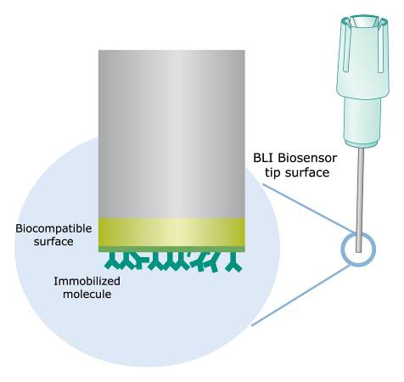
Biosensor Surface Chemistry
|---- 600 μm ----|
Two-dimensional binding surface
Biocompatible Matrix - minimizes non-specific binding
Uniform
Non-denaturing

Slide 16
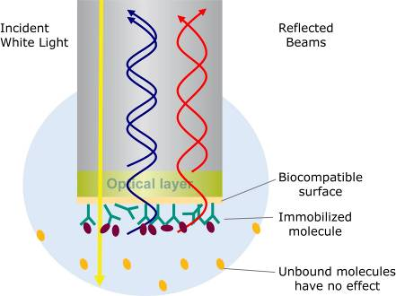
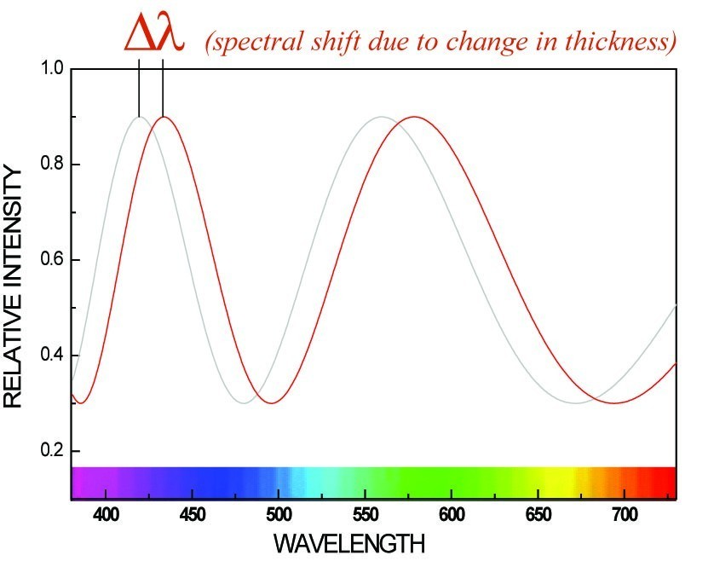
Biolayer Interferometry (BLI)
Optical layer reflects simple white light; second reflection from tip of biosensor, both reach detector
Analyte binding changes thickness of bio-layer, which is measured at detector

Slide 17
BLI Biosensor Types Available
Biosensor | Application
Antibody-Specific Capture
• Anti-Human IgG Fc Capture (AHC) | Human IgG Fc region, kinetic analysis
• Anti-Human IgG Fc Capture (AHQ) | Human IgG Fc region, quantitation
• Anti-Mouse Fc Capture (AMC) | Mouse IgG1, 2a & 2b Fc regions, kinetic analysis
• Anti-Mouse Fc Capture (AMQ) | Mouse IgG1, 2a & 2b Fc regions, quantitation
• Anti-Human Fab-CHI (FAB) | Fab-CH1 domains of human IgG
• Protein A (ProA) | Quantitation of various species IgG
• Protein G (ProG) | Quantitation of various species IgG
• Protein L (ProL) | Quantitation of IgG via kappa light chain
Affinity Tag Capture
• Streptavidin (SA) | Biotinylated ligands
• High Precision Streptavidin (SAX) | Biotinylated ligands (4% CV)
• Super Streptavidin (SSA) | Biotinylated ligands (high-density surface, small molecules)
• Anti-GST (GST) | GST-tagged recombinant proteins
• Anti-Penta HIS (HIS) | HIS-tagged recombinant proteins
• Anti-Penta HIS 2nd Gen (HIS2) | HIS-tagged recombinant proteins
• Ni-NTA (NTA) | HIS-tagged recombinant proteins
Immobilization
• Amine Reactive 2nd Gen (AR2G) | Covalent coupling to reactive amine groups
• Aminopropylsilane (APS) | Adsorption to hydrophobic moieties

Slide 18
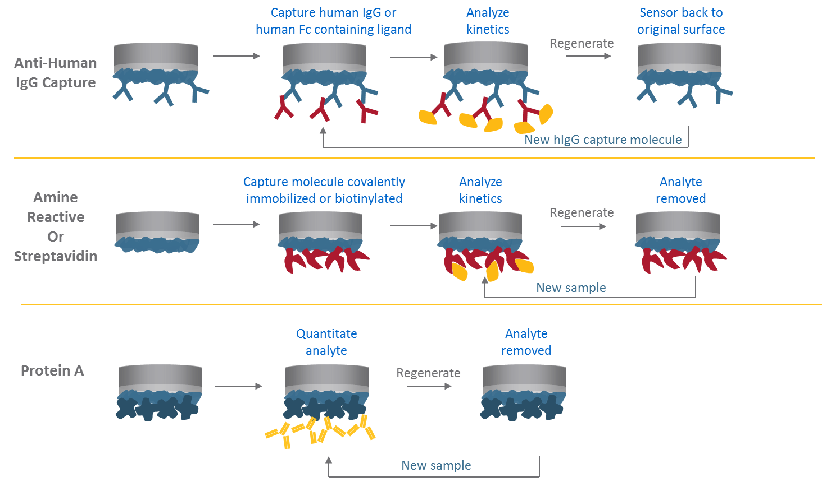
Biosensor regeneration

Slide 19

Octet can successfully measure binding in a variety of complex matrices
Sandy soil
Pollen
Diesel Fuel
Milk
Honey
Shellfish slurry
Chicken slurry
Wheat Flour slurry
Beef slurry
Crude Corn Extracts
Lecithin (Brown Fat)
Many types of media and blood plasma types
Methanol
Cell lysates
DMSO

Slide 20
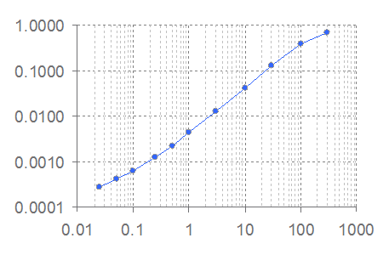
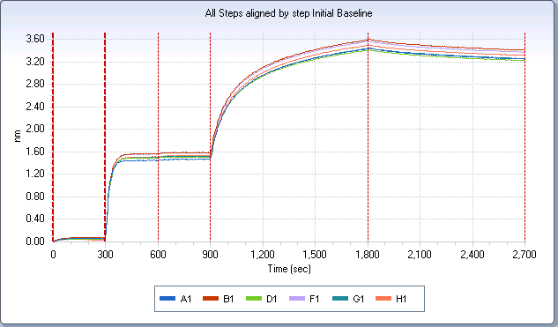
Information Provided by Octet Platform
Protein/Antibody Concentration
Picogram to milligram dynamic range
Contaminant testing
Immunogenicity
Residual Protein A Detection
HCP Detection
Affinity characterization of proteins, antibodies, and small molecules
Binding K_{D}
On and off rates
Rank order
Yes / No kinetic screening
Epitope binning / mapping
Signal
Concentration

Slide 21
Quantitation Biosensors
Biosensor | Application
Antibody-Specific Capture
• Anti-Human IgG Fc Capture (AHC) | Human IgG Fc region, kinetic analysis
• Anti-Human IgG Fc Capture (AHQ) | Human IgG Fc region, quantitation
• Anti-Mouse Fc Capture (AMC) | Mouse IgG1, 2a & 2b Fc regions, kinetic analysis
• Anti-Mouse Fc Capture (AMQ) | Mouse IgG1, 2a & 2b Fc regions, quantitation
• Anti-Human Fab-CHI (FAB) | Fab-CH1 domains of human IgG
• Protein A (ProA) | Quantitation of various species IgG
• Protein G (ProG) | Quantitation of various species IgG
• Protein L (ProL) | Quantitation of IgG via kappa light chain
Affinity Tag Capture
• Streptavidin (SA) | Biotinylated ligands
• High Precision Streptavidin (SAX) | Biotinylated ligands (4% CV loaded SA)
• Super Streptavidin (SSA | Biotinylated ligands (high-density surface)
• Anti-GST (GST) | GST-tagged recombinant proteins
• Anti-Penta HIS (HIS) | HIS-tagged recombinant proteins
• Anti-Penta HIS 2nd Gen (HIS2) | HIS-tagged recombinant proteins
• Ni-NTA (NTA) | HIS-tagged recombinant proteins
Immobilization
• Amine Reactive 2nd Gen (AR2G) | Covalent coupling to reactive amine groups
• Aminopropylsilane (APS) | Adsorption to hydrophobic moieties

Slide 22
Octet Automated Workflow for Quantitation
Octet Biosensors
Standards
Binding (nm)
Test Samples
Time (sec)
120
Data is taken for 2minutes per 8 wells
96 wells in ~30 minutes
1 step, no washing
Binding Rate
Concentration

Slide 23
Octet Workflow for Quantitation with Regeneration
Octet Biosensors
Standards
Binding (nm)
Test Samples
Time (sec)
120
Regen
Buffer/Neut.
The binding rates of test samples are measured and interpolated from the standard curve to determine concentration
96 samples analyzed in 15 - 30 minutes
Reuse of standard curve is optional
Binding Rate
Concentration
Notes:
23

Slide 24
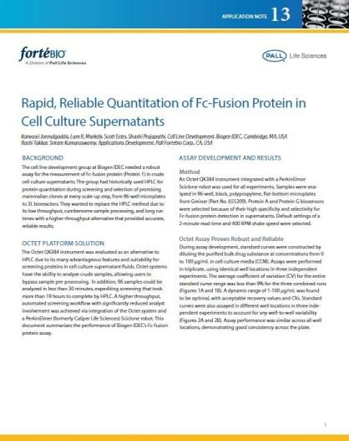
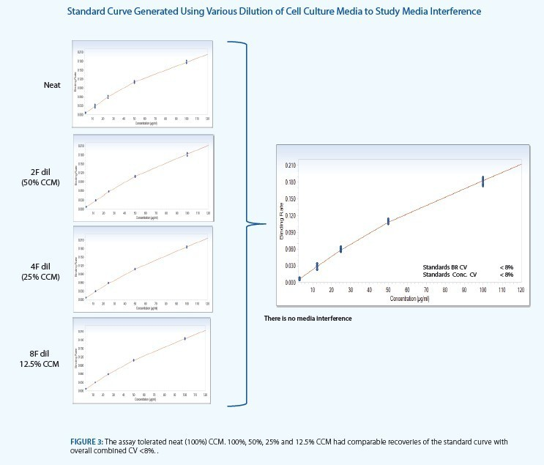
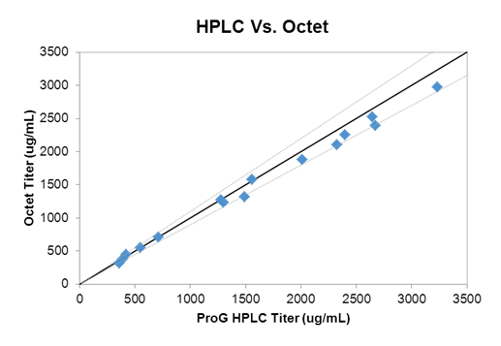
Octet Assays Successfully Replace HPLC in CCD at Biogen Idec
Biogen IDEC:
Fc-fusion protein
Protein G HPLC vs Octet ProG Quant
96 samples: 19 hr reduced to 20 min
Intermediate assay precision %CV <5% (n=54)
100%, 50%, 25%, and 12.5% CCM had comparable standard curves with overall combined CV <8%

Slide 25
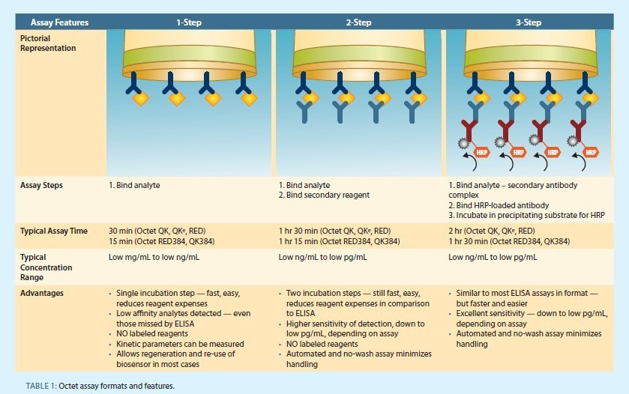
Octets can Replace Lengthy ELISAs

Slide 26
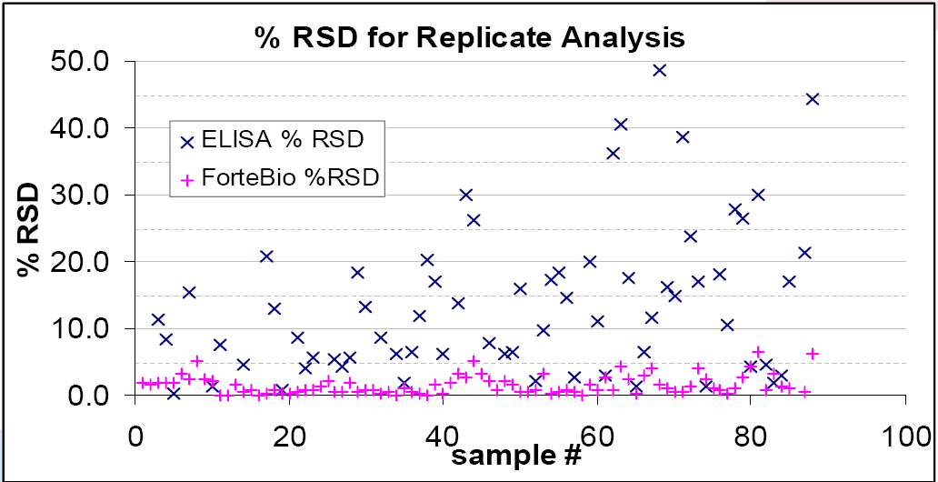
Octet Reproducibility and Comparison to ELISA
Typical RSD Values:
Data presented at IBC Antibody Production, 2008 by Keith Davis from Pfizer MO.
ELISA | 5 - 20%
Octet | < 5%
Notes:
Data from Keith Davis, Pfizer St. Louis.
The Octet does not suffer from the variability introduced to the assay by pipetting, coating, blocking, and repeated washing. The factors can also compound.

Slide 27
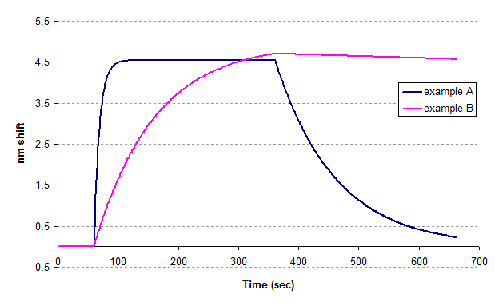
Real-Time Kinetics Provides Better Binding Information Over ELISA
ELISA methods only provide approximations of K_{D}.
Different combinations of k_{on} and k_{off} can give the same affinity measurement.
These two compounds appear to have the same KD, however Example B has a 100x tighter dissociation than Example A. For this pharmaceutical application, a tighter dissociation would be preferred.
Washing steps in ELISA methods will remove weak antibody interactions, and thus are not feasible to use for characterization.
 | Association | Dissociation | K_{D} = Affinty
Example A | 1.00E+04 | 1.00E-02 | 1.00E-06
Example B | 1.00E+02 | 1.00E-04 | 1.00E-06

Slide 28
Kinetic Biosensors
Biosensor | Application
Antibody-Specific Capture
• Anti-Human IgG Fc Capture (AHC) | Human IgG Fc region, kinetic analysis
• Anti-Human IgG Fc Capture (AHQ) | Human IgG Fc region, quantitation
• Anti-Mouse Fc Capture (AMC) | Mouse IgG1, 2a & 2b Fc regions, kinetic analysis
• Anti-Mouse Fc Capture (AMQ) | Mouse IgG1, 2a & 2b Fc regions, quantitation
• Anti-Human Fab-CHI (FAB) | Fab-CH1 domains of human IgG
• Protein A (ProA) | Quantitation of various species IgG
• Protein G (ProG) | Quantitation of various species IgG
• Protein L (ProL) | Quantitation of IgG via kappa light chain
Affinity Tag Capture
• Streptavidin (SA) | Biotinylated ligands
• High Precision Streptavidin (SAX) | Biotinylated ligands (4% CV loaded SA)
• Super Streptavidin (SSA | Biotinylated ligands (high-density surface)
• Anti-GST (GST) | GST-tagged recombinant proteins
• Anti-Penta HIS (HIS) | HIS-tagged recombinant proteins
• Anti-Penta HIS 2nd Gen (HIS2) | HIS-tagged recombinant proteins
• Ni-NTA (NTA) | HIS-tagged recombinant proteins
Immobilization
• Amine Reactive 2nd Gen (AR2G) | Covalent coupling to reactive amine groups
• Aminopropylsilane (APS) | Adsorption to hydrophobic moieties

Slide 29
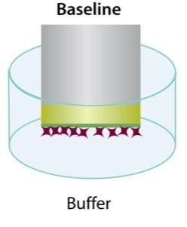
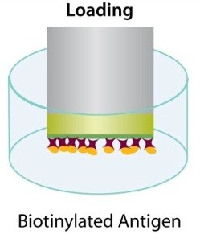
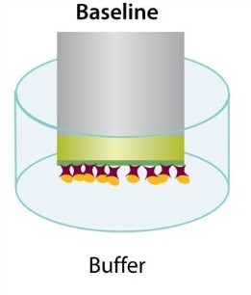
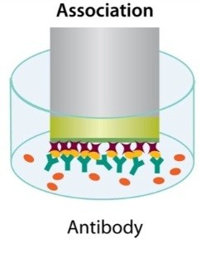
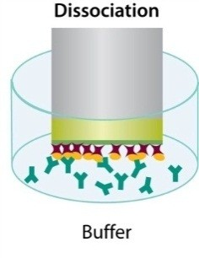
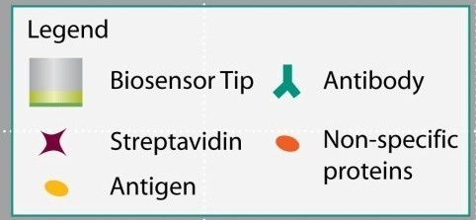
Automated Kinetic Characterization on the Octet
Baseline
Baseline
Loading
Octet Biosensors
Buffer
Binding (nm)
Capture molecule
Analyte of Interest
Association
Dissociation
Time
8 or 16 samples can be analyzed in parallel
Measure on rates and off rates, multiple binding models
Data is displayed in real-time
Experimental protocols can be customized

Slide 30
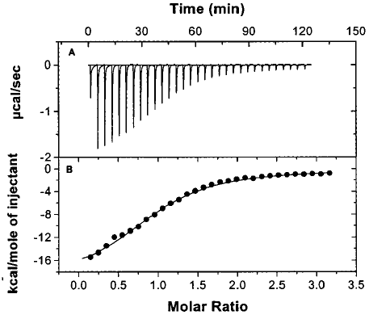
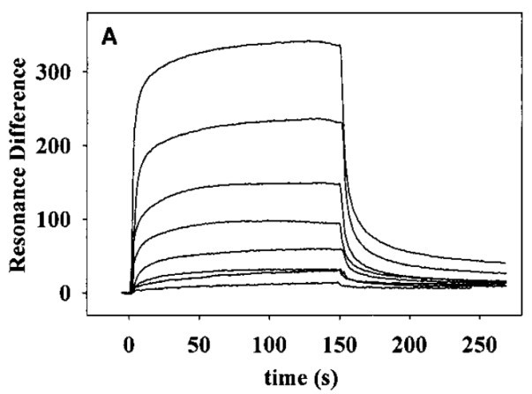
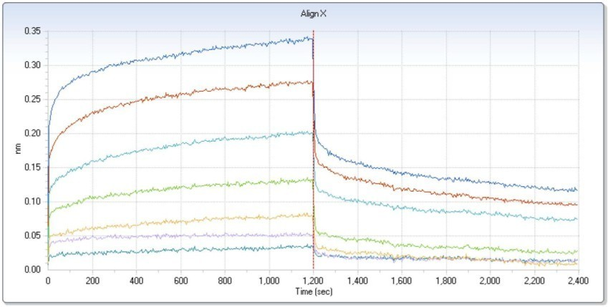
Para Thyroid Hormone (PTH) Binding to PTH Receptor (Octet) Biotin-PTH1R ECD on SA biosensor – PTH(1-34)NH₂ in solution. (Biacore) PTH1R on CM5 chip – PTH(1-34)NH₂ in solution. Van Andel Research Institute, Massachusetts General Hospital
Instrument | K_{D}
Biacore X | 4.9 µM
ForteBio Octet RED | 2.8 µM
Microcal iTC | 3.4 µM
PTH is of clinical interest for its ability to stimulate bone formation.
(Octet) J. Biol. Chem. 2009, 284, 28382-28391.
(Biacore) Biochemistry, 2000, 39, 8878-8887.
Notes:
Overview:
Van Andel scientists performed experiments on Octet RED system, which are published in the JBC2009 paper. In the paper, they mentioned good match of results to biacore and ITC data from previously published Biochemistry 2000 paper.
Experiment details:
Biotinylated para thyroid hormone (PTH) receptor was loaded on Streptavidin biosensors and dipped into solutions of PTH protein in solution. Biacore experiments were performed on CM5 chip (amine reactive chemistry).
Conclusions:
Good match of data between Octet, Biacore and ITC as per publication by academic users. Data further shows reliability of biotinylation approach on Octet systems.

Slide 31
APPLICATIONS Of THE OCTET –BLI TECHONOLOGY

Slide 32
Rapidly Develop Optimal Assay Conditions
Peptide 1: Antibody
K_{D} = 2.6nM
Peptide 2: Antibody
K_{D} = 460pM
Step 1:
Test two antibodies at four concentrations for affinity to target
Step 2:
Test optimal NaCl concentration
Step 3:
Test optimal Tween concentration
Step 4:
Test optimal concentration of carrier protein.
All experiments were completed
in one afternoon.
Successful conditions were used for HTP bead-based assay.
50mM HEPES + 0mM NaCl
+50mM NaCl
+100mM NaCl
+150mM NaCl
1400.0
0% v/v Tween
0.001% v/v Tween
0.005% v/v Tween
0.01% v/v Tween
1400.0
1600.0
1800.0
2000.0
1000.0
1200.0
1400.0
0 mg/ml BSA
0.1mg/ml BSA
0.5mg/ml BSA
1.0 mg/ml aBSA
1000.0
1200.0
1400.0
Notes:
Rapid assay development for an alpha screen assay. Best conditions from each step were carried forward into the next step. The last assay is an accumulation of all conditions. The customers normal methodology for developing these conditions would have taken 1+ weeks.

Slide 33
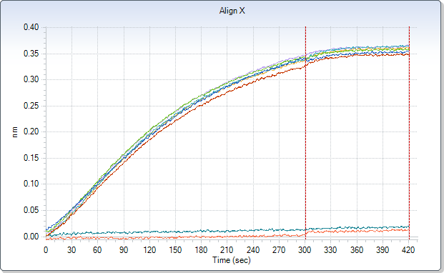
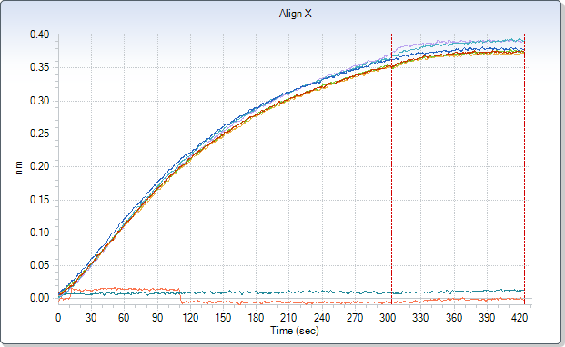
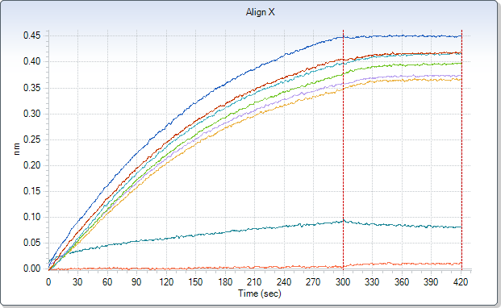
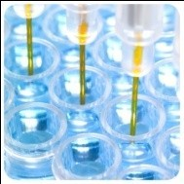
Detection of Recombinant 34kD Antigen (300 nM) Binding to Specific Monoclonal Antibody in Complex Matrices
Sage Pollen 1:20 – 1:1280
Diesel Fuel 1:200 – 1:12800
matrix dilutions
matrix dilutions
buffer and matrix neg ctls
buffer and matrix neg ctls
No matrix effect in dilutions of pollen and diesel fuel tested
Despite small matrix effect at more concentrated dilutions of soil, the Octet can successfully differentiate +/- binding
Sandy Soil 1:20 – 1:1280
matrix dilutions
Octet RED96 parameters:
Standard 96W plate
mAb immobilized on AMC Biosensors
30⁰C, 1000 RPM
10 minute association
Matrix and Buffer neg ctl run for each matrix tested
300nM rAg run in buffer as pos ctl
Qualitative analysis: yes/no binding of 300nM rAg in various dilutions of matrix
buffer and matrix neg ctls

Slide 34
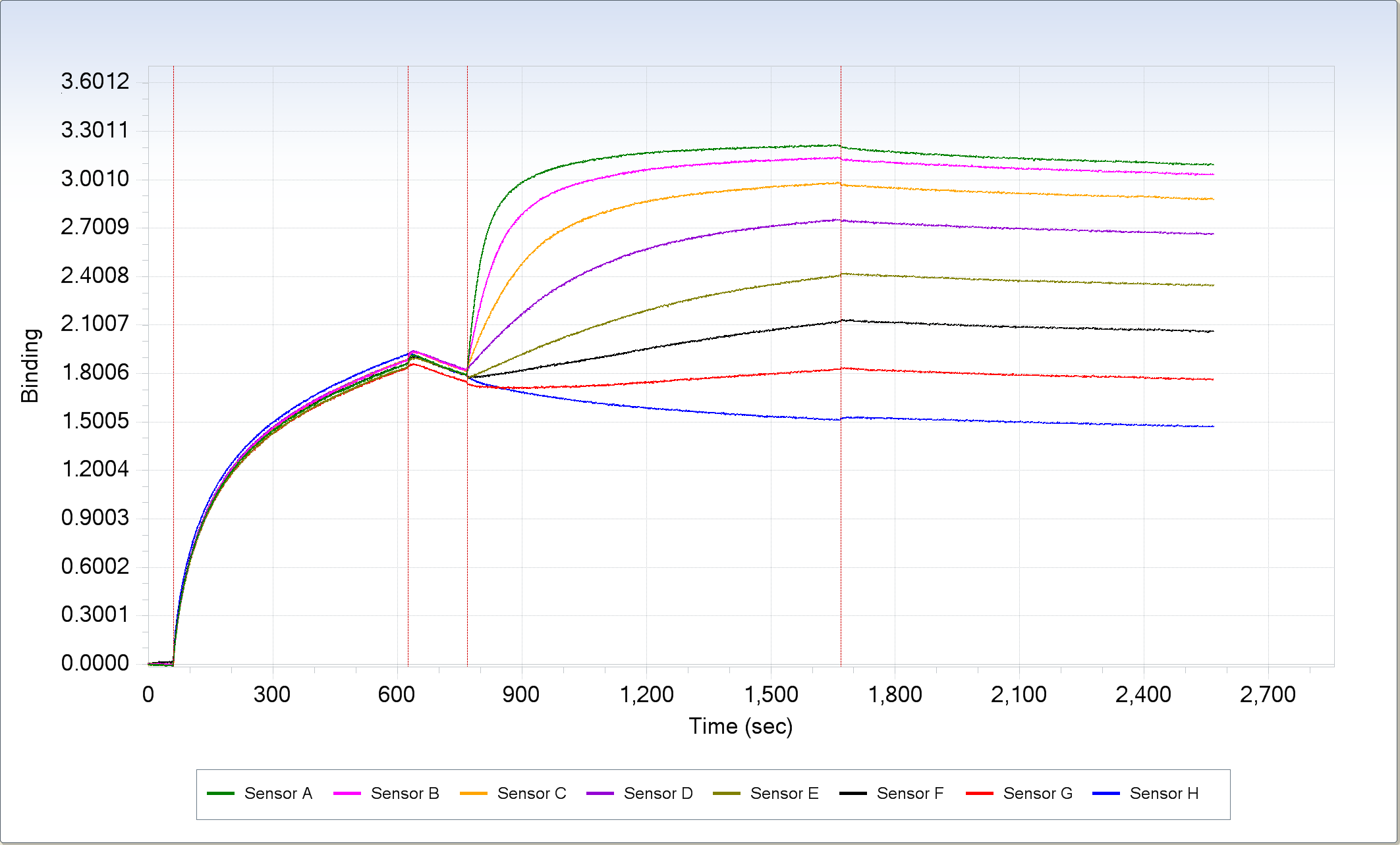

Binding of Antibody 5F12 to His-Tagged Protein on Octet RED
His-tagged
Protein Loading
Wash
Association
Dissociation
10 nM
5 nM
2.5 nM
1.25nM
625 pm
313 pM
156 pM
Blank
Binding (nm)
Time (sec)
Octet Red parameters:
Standard 96W plate
Bio-Ni-NTA coated SA Biosensors
30⁰C, 1000 RPM
10 minute association/10 minute dissociation
Kinetics:
ka = 1.9e6
kd = 5.2e-5
KD = 27 pM

Slide 35
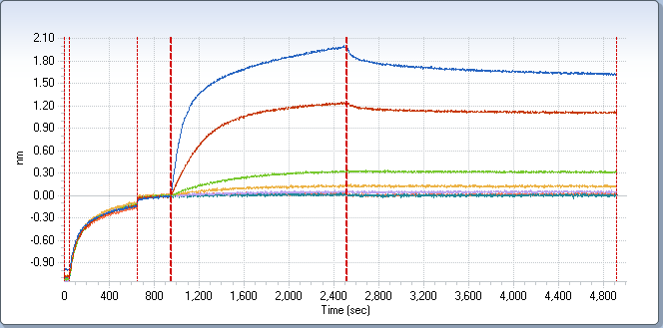
DNA-Binding Protein Kinetic Analysis on the Octet QK
Biotin-
DNA
Protein
Dissociation in Buffer
k_{d} | k_{a} | K_{D}
4.78E-05 | 5.59E+04 | 8.55E-10
Binding of DNA-Binding Protein to Immobilized Biotinylated ssDNA
Rapid Analysis of Binding of Transcription Factors and Other Promoter Elements to Specific DNA Sequences
Notes:
Binding buffer = 20 mM Tris, 150 mM KOAc, 10 mM MgOAc
Octet QK

Slide 36
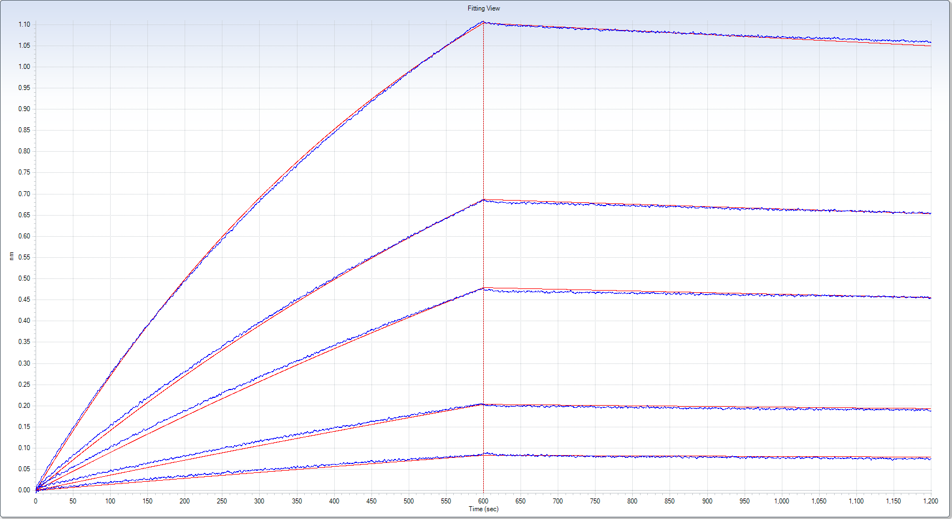
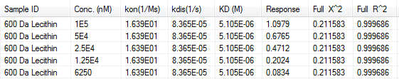
Detection of Lecithin (Brown Fat) binding to 6kDa peptide by OctetRED96
Octet RED96 parameters:
Standard 96W plate
6 kDa peptide coated SA Biosensors
30⁰C, 1000 RPM
10 minute association/10 minute dissociation all phosphate buffer pH 6.5
Kinetic parameters determined using non-linear Global Fitting
Octet can successfully monitor interaction of very sticky, fatty molecules to accurately measure kinetic parameters.

Slide 37





Measuring Avidity on the OctetRED96
S1, KD=1.81nM
S2, KD=0.84nM
S3, KD=2.34 nM
Octet Red96 parameters:
Standard 96W plate
Antigen coated SA Biosensors
30⁰C, 1000 RPM
5 minute association/10 minute dissociation all in in 4%, 2% or 1% serum
Kinetic parameters determined using non-linear Global Fitting
S4, KD=0.81nM
S5, KD=0.37 nM
Real-time results available immediately allowing fast-
ranking of avidity samples.

Slide 38
Octet Approach For Cooperative/Allosteric Binding Events
The classical allosteric interaction is: A and B binds, addition of C increases (or decreases) the binding of B to A. So one needs to figure out how C affects the binding. In many cases the allosteric effects occur due to the change of conformation of B upon the addition of C, thus affecting the interaction between A and B. Receptor is typically undergoes such conformational change.
Approach: (1) Determine pair-wise affinity (interaction), A - B, B - C, C - A. (2) if we assume C changes the conformation of B, perform A-B interactions (fixed A and B conc, say A is immobilized and B is in solution), with increased concentrations of C into analyte, to titrate for C concentration needed to see the new A-B binding profile until the A-B interaction no longer changes; (3) Use this C concentration throughout in the matrix, keep A immobilized, titrate B concentrations to get full kinetics of A and B under the cooperative conditions.

Slide 39
Publications on Cooperative/Allosteric Binding Using BLI as Detection Platform
An Unusual Repressor Controls the Expression of the Crucial Nicotine-Degrading Gene Cluster in Pseudomonas Putida S16; Molecular Microbiology (2014)
Biolayer Interferometry for Measuring Kinetics of Protein-Protein Interactions and Allosteric Ligand Effects; Journal of Visualized Experiments ((2014)

Slide 40

Cooperative Binding of 2 Nic2 dimers to target DNA
An Unusual Repressor Controls the Expression of a Cruicial Nicotine-Degrading Gene Cluster in Pseudomonas putida S16, Molecular Microbiology (2014)
Binding signals at equilibrium evaluated. Hill plot for NicR2 binding to fragment b shown below.
Experiments performed on Octet RED96

Slide 41
Hit Identification and Lead Confirmation in the Discovery of Drugs Targeting Bromodomain Proteins
Liu Liu¹, Yujun Zhao¹, Xu Ran¹, Yongqiang Zhu¹, Longchuan Bai¹, Donna McEachern¹, Chao-Yie Yang¹, Jennifer Meagher², Jeanne Stuckey², Shaomeng Wang¹
Department of Internal Medicine and Comprehensive Cancer Center,
2. Life Sciences Institute,
University of Michigan, Ann Arbor, MI 48109

Slide 42
Application of the Octet RED96 system
Assay development and optimization after target determined
accuracy: compared with results from other well- established assays; misleading data is worse than no data
reproducibility, stability, cost, feasibility
Find proper sensors: SSA sensors for small molecules; possible less expensive alternatives
Protein immobilization conditions: Biotinylation, protein concentrations, buffer conditions
Assay condition optimization, data interpretation
Help needed from the manufacturers, particularly in the initial stages; fairly quick and straightforward

Slide 43





K_{D} values of reference compounds to BRD4BD2 determined by BLI
Assays developed in a couple days
Super Streptavidin (SSA) sensors, PBS with 0.1% BSA, 0.01% Tween-20, 0.5% DMSO
Inactive blocked Streptavidin and buffer as double references
CMPDs |  | IBET-762 | PFI-1
MW |  | 424 | 374
BRD4BD1 | OctetRED | 147 | 131
 | Published | 53* | 136
BRD4BD2 | OctetRED | 54 | 380
 | Published | 53* | 303
K_{D} = 54nM
K_{D} = 380nM
* BRD4 BD1-2, both reported data and our own data suggested no significant difference between BD1-2 and BD1 and BD2.
K_{D} = 100nM

Slide 44






















































Screening to BRD4BD2
Hit 1
Hit 2
Hit 3
250µM, 0.5% DMSO, finished in a few hours
Positive hits: > average of buffer + 3 SD
Hit 1, 2, 3 are derivatives from the same scaffold.

Slide 45



Hit confirmation by dose dependence titration
CMPD | MW | K_{D} (µM) | k_{on} (1/Ms) | k_{dis} (1/s)
Hit 1 | 133 | 89.2 | 2.21E+02 | 1.97E-02
Hit 2 | 210 | 42.5 | 5.57E+02 | 2.37E-02
Hit 3 | 211 | 14.9 | 1.52E+03 | 2.27E-02

Slide 46






Binding affinities of Hit 3 to other BET-BRDs
BETs | K_{D} (µM)
BRD3BD1 | 58.7
BRD4BD1 | 14.9
BRD4BD2 | 18.3

Slide 47
Direct Comparison of Octet RED to Biacore Published Results
Compound | ForteBio | Biacore ^{1,2}
Acetazolamide 222 Daltons | K_{D} = 0.039 µM | K_{D} = 0.039, 0.019 µM
Benzenesulfonamide 157 Daltons | K_{D} = 2.4 µM | K_{D} = 0.8, 0.85 µM
Furosemide 330 Daltons | K_{D} = 1.2 µM | K_{D} = 1.0, 0.51 µM
Sulpiride 341 Daltons | K_{D} = 239 µM | K_{D} = 48, 186 µM
Results were within 3x and considered equivalent for affinity.
1. Papalia et al, Analytical Biochem. 359 (2006), 94-105
2. Myszka, Analytical Biochem. 329 (2004), 316-323

Slide 48
Comparable to Biacore in a Roche Blind Study: 12/12 Match
MW (Dalton) | ForteBio (uM) | Biacore (uM)
258 | 0.560 | 0.396
162 | 0.139 | 0.458
268 | 1.24 | 3.31
282 | 4.0 | 5.7
296 | 0.635 | 0.246
331 | 10.31 | 5.57
295 | 1.46 | 1.28
269 | 11.78 | 4.63
269 | 0.261 | 0.418
221 | 1.68 | 1.88
324 | No Binding | No Binding
300 | No Binding | No Binding
Customer Requirement:
Results must be within 2-3X of Biacore values
= Equivalent
Test for non-specific
binding property
of sensors

Slide 49


Typical Epitope Binning Assay Formats Cross-Blocking Assays To Establish Antibody Diversity
All Octet systems can perform binning in all three binning formats
Discrete, parallel and independent processing of multiple interactions (8-96 channels) simultaneously on Octet systems

Slide 50

Octet QK enables fast Epitope Mapping / Epitope Binning
ALDER Antibody | Epitope Bin
Ab 1 | IV
Ab 2 | I
Ab 3 | I
Ab 4 | II
Ab 5 | III
Ab 6 | II
Ab 7 | II
Ab 8 | I
Ab 9 | IV
Ab 10 | IV
Easily resolved blocking of extra epitope on dimeric antigen by incubating with non-biotinylated Control Ab prior to screening other Abs
Notes:
Easily resolved blocking of extra epitope on dimer antigen by incubating with unbiotinylated Control Ab

Slide 51


Take the Pain Out of Epitope Binning
Save & Export Raw Data
6-8 hours for analysis of matrix data
Tedious work in Excel
Not all formats work
Still being done with ELISA
Microsoft Excel Macro:
Chops the long binding cycle with 16 regenerations into individual cycles & saves data as text file
Scrubber 2.0c:
Open the saved text file
Measure Binding Responses:
Antigen captured
mAb-1 binding
mAb-2 binding

Slide 52

Biopharm Portal at www.fortebio.com

Slide 53
User Specific Questions
Yiran Wang -
My research topic is about interaction between RNA and virus like particle. I have already tried it on BLItz and found some interaction between my virus like particle and yeast's total RNA. Now I want to get more kinetic information with BLItz or Octet. My problem is that the results are not consistent with each other even in the exact same condition. I want to use Octet to set up a suitable buffer system to continue my study.
I would like to hear more about virus like particle binding and how to adjust buffer to obtain a reliable results. Besides, I want to learn more about different models the software used.

Slide 54
2. Buenafe T. Arachea, Ph.D. Enzymatic assays in detergent micelle, membrane lipid and nanodiscs environment examples-
3. Iga Kucharska- Interested in protein-small molecule kinetics examples

Slide 55


Accommodating Bivalent Analytes with a Capture-Based Assay Format
Y
Target molecule
Y
Y
Bivalent molecule
Y
Bivalent molecule
Target molecule
Anti Human capture sensor surface
Sensor surface
Complex Curves
1:1 Homogeneous Curves

Slide 56
Bivalent Analyte (Antigen-Antibody)
An artifact of the surface interaction resulting in slower dissociation (avidity).
Formation of AB complex
Formation of AB2 complex
k
a1
A
+
B
A
B
k
d1
k
AB
+
B
a2
A
B2
k
d2
Notes:
This is an example of a ‘linked’ interaction, where the formation of AB2 cannot proceed before the formation of AB, and AB cannot dissociate before the dissociation of AB2

Slide 57
Bivalent Analyte (Antigen-Antibody)
Formation of AB complex
Formation of AB complex
k
a1
A
+
B
A
B
k
d1
Avidity can be eliminated by optimizing (lowering) the loading concentration
Therefore even though you have a bivalent molecule, you have optimized for 1:1 binding
Notes:
This is an example of a ‘linked’ interaction, where the formation of AB2 cannot proceed before the formation of AB, and AB cannot dissociate before the dissociation of AB2

Slide 58


Slide 59


Kinetic Characterization of Protein:Protein Interactions
Example:
3) You can identify which clones have well defined binding interactions and which have complex binding interactions
Binding saturates
Super-stoichiometric binding
Single exponential
Returns to baseline
Biphasic on, off curves
No NSB!
Specific binding
+ non-specific binding?
Well behaved 1:1 binding interaction
Undesirable complex binding interactions

Slide 60
Heterogenous Binding
Heterogeneous binding signal is typically the result of a non-specific binding interaction contaminating the specific binding signal
Take steps to eliminate the non-specific interaction
Analyte concentrations may be too high
Ligand loading level may be too high
Association time might be too long
Assay buffer may need some optimization to reduce non-specific interactions
Reference sensor may show similar non-specific signal increase, which may be subtracted from the binding signals

Slide 61
Different Types of NSB
Bare Sensor
Loaded Sensor
NSB
NSB
Analyte
Analyte

Slide 62
Minimizing NSB on Biosensors
Buffer Optimization
BSA
Salt
Detergent
Biotinylated irrelevant protein to block surface
Biotinylated BSA to block surface
Biocytin to block SA binding pockets
More BSA to block surface (mg/mL range)
Other options for blocking agents:
Non-fat milk
Casein
Irrelevant IgG (mg/mL range)
Bare Sensor
Analyte

Slide 63
NSB Mechanisms
Coulombic interaction
Charge of surface, charge of molecule
Isoelectric Point (pI) of analyte
Ionic strength of solvent is low
Non-covalent binding
Van der Walls interactions
Hydrophobic interactions
Analyte solubility
Organic compounds
Aqueous solvent insolubility
Others
Biological similarities
Streptavidin to Fibronectin
Buffer pH/salt
concentration
Raise surfactant level in buffers
Add BSA and/or Casein
Raise DMSO content in assay buffer
Reduce concentration of compound
Add glycerol
Blocking open binding sites
with Biocytin

Slide 64
THANK YOU
Mahasti Alavi, Mid-Atlantic Sales Manger
Mahasti_alavi@pall.com
Bob Dass, Mid-Atlantic FAS
Bob_dass@pall.com

Slide 65
Heterogeneous Ligand Model
The 2:1 heterogeneous ligand model assumes analyte binding at
two independent ligand sites. Each ligand site binds the analyte
independently and with a different rate constant. Two sets of rate
constants are given, one for each interaction:
A + B1 AB1
ka1
kd1
A + B2 AB2
ka2
kd2
where A represents the analyte and B represents the immobilized
ligand.

Slide 66
1:2 Bivalent Analyte
The 1:2 Bivalent Analyte model fits the binding of one bivalent
analyte to a monomeric immobilized ligand. Kinetic parameters are
calculated for two interactions (ka1, ka2, kd1, kd2, KD1, KD2).
A+B AB AB+B AB2
ka1
kd1
ka2
kd2
This model assumes that because of limited distance between two
adjacent binding sites on the surface, the bivalent analyte can form
a bridged complex.

Slide 67
Assay Development

Slide 68
Microplates
A minimum of 2 microplates is required for every Octet assay (pre-wet plate and sample plate)
Octet QKe and Octet Red96: 96 well plates
Octet QK384 and Octet Red384 and HTX can use 96 well plate or 384 well plates
96 well plates: 200uL volume required
384 well plates: 120uL volume required
384 tilted-well plates (Red384 only): 50uL
Plates need to be Greiner black, polypropylene, flat bottom plates
Black 96 well plates: Greiner catalogue # 655209
Black 384 well plates: Greiner catalogue # 781209
Black 384 tilted-well plates: ForteBio 18-5080 or 18-5076
Sample is recoverable and measurement non-destructive.

Slide 69
Part 2: Quantitation on the Octet

Slide 70
Quantitation Biosensors
Biosensor | Application
Antibody-Specific Capture
• Anti-Human IgG Fc Capture (AHC) | Human IgG Fc region, kinetic analysis
• Anti-Human IgG Fc Capture (AHQ) | Human IgG Fc region, quantitation
• Anti-Mouse Fc Capture (AMC) | Mouse IgG1, 2a & 2b Fc regions, kinetic analysis
• Anti-Mouse Fc Capture (AMQ) | Mouse IgG1, 2a & 2b Fc regions, quantitation
• Anti-Human Fab-CHI (FAB) | Fab-CH1 domains of human IgG
• Protein A (ProA) | Quantitation of various species IgG
• Protein G (ProG) | Quantitation of various species IgG
• Protein L (ProL) | Quantitation of IgG via kappa light chain
Affinity Tag Capture
• Streptavidin (SA) | Biotinylated ligands
• High Precision Streptavidin (SAX) | Biotinylated ligands (4% CV loaded SA)
• Super Streptavidin (SSA | Biotinylated ligands (high-density surface)
• Anti-GST (GST) | GST-tagged recombinant proteins
• Anti-Penta HIS (HIS) | HIS-tagged recombinant proteins
• Anti-Penta HIS 2nd Gen (HIS2) | HIS-tagged recombinant proteins
• Ni-NTA (NTA) | HIS-tagged recombinant proteins
Immobilization
• Amine Reactive 2nd Gen (AR2G) | Covalent coupling to reactive amine groups
• Aminopropylsilane (APS) | Adsorption to hydrophobic moieties

Slide 71

Octet Automated Workflow for Quantitation
Protein A sensor
IgG standard
Purified sample,
Cell culture supernatant,
Crude lysate, etc.
Capture Protein
Notes:
How does it work? This is the tip of a fiber. We coat the tip end with a special optical layer. The capturing molecule is then attached to the tip. The tip is dipped into the sample containing target molecule. The target molecule binds to the capture molecule, and two form a molecular layer. A white light is directed into the fiber. Two beams will be reflected to the back end. The first beam comes from the tip as a reference. The second light comes from the molecular layer. The difference of two beams will cause a spectrum color pattern as shown here. The phase is a function of the molecular layer thickness and corresponding to the number of molecules on the tip surface.

Slide 72
Octet Workflow for Quantitation
Octet Biosensors
Standards
Binding (nm)
Test Samples
Time (sec)
120
The binding rates of test samples are measured and interpolated from the standard curve to determine concentration
96 samples analyzed in 15 - 30 minutes
Reuse of standard curve is optional
Binding Rate
Concentration
Notes:
72

Slide 73
Octet Workflow for Quantitation with Regeneration
Octet Biosensors
Standards
Binding (nm)
Test Samples
Time (sec)
120
Regen
Buffer/Neut.
The binding rates of test samples are measured and interpolated from the standard curve to determine concentration
96 samples analyzed in 15 - 30 minutes
Reuse of standard curve is optional
Binding Rate
Concentration
Notes:
73

Slide 74
Instrument Flexibility Offers Wide Dynamic Range Octet RED96/RED384
mg/ml …Dynamic range...pg/mL
Direct 400
Direct 1000
Sandwich
ELISA
HRP-tagged antibody
Y
Y
Y
Y
Y
Y
Y
Y
Y
Y
Y
Y
Y
Y
Y
Y
Y
Y
Y
Y
Y
Y
Y
Y
Y
Y
Y
Y
Y
Precipitating substrate
1: Analyte
1: Analyte
2: Sandwich
1: Analyte
1: Analyte
2: Sandwich
3: Amplification
Flow Rate:
Sample Incubation:
Amplification Step(s):
400RPM
2 min/column
N/A
1000RPM
5 min/column
N/A
1000RPM
30-60 minutes
2 min/column
1000RPM
30-60 minutes
5 min/column
Direct 400 = 2000 -0.5 µg/mL
Sandwich = 500 -0.1 ng/mL
Direct 1000 = 300 -0.025 µg/mL
ELISA = 200 -0.01 ng/mL
Results will vary with assay and matrix

Slide 75


Time and Shake Speed Optimization
Expected conc (µg/mL) | 200 rpm 2 min read time |  | 1000 rpm 5 min read time
 | Ave conc N=5 (µg/mL) | %CV N=5 | Ave conc N=4 (µg/mL) | %CV N=4
2000 | 2157.3 | 9% | --- | ---
1500 | 1481.6 | 3% | --- | ---
1000 | 958.2 | 2% | --- | ---
700 | 696.9 | 2% | --- | ---
500 | 485.5 | 1% | --- | ---
300 | 308.3 | 1% | 301.0 | 2%
100 | 105.6 | 1% | 100.1 | 1%
30 | 29.9 | 1% | 30.1 | 2%
10 | 9.3 | 2% | 10.0 | 1%
3 | 3.2 | 5% | 3.0 | 5%
1 | 1.0 | 2% | 1.0 | 1%
0.50 | 0.5 | 3% | 0.50 | 2%
0.25 | --- | --- | 0.25 | 3%
0.10 | --- | --- | 0.10 | 4%
0.05 | --- | --- | 0.05 | 8%
200 RPM
1000 RPM
All data on Octet RED

Slide 76
Part 3: Kinetic Characterization on the Octet

Slide 77
Kinetic Biosensors
Biosensor | Application
Antibody-Specific Capture
• Anti-Human IgG Fc Capture (AHC) | Human IgG Fc region, kinetic analysis
• Anti-Human IgG Fc Capture (AHQ) | Human IgG Fc region, quantitation
• Anti-Mouse Fc Capture (AMC) | Mouse IgG1, 2a & 2b Fc regions, kinetic analysis
• Anti-Mouse Fc Capture (AMQ) | Mouse IgG1, 2a & 2b Fc regions, quantitation
• Anti-Human Fab-CHI (FAB) | Fab-CH1 domains of human IgG
• Protein A (ProA) | Quantitation of various species IgG
• Protein G (ProG) | Quantitation of various species IgG
• Protein L (ProL) | Quantitation of IgG via kappa light chain
Affinity Tag Capture
• Streptavidin (SA) | Biotinylated ligands
• High Precision Streptavidin (SAX) | Biotinylated ligands (4% CV loaded SA)
• Super Streptavidin (SSA | Biotinylated ligands (high-density surface)
• Anti-GST (GST) | GST-tagged recombinant proteins
• Anti-Penta HIS (HIS) | HIS-tagged recombinant proteins
• Anti-Penta HIS 2nd Gen (HIS2) | HIS-tagged recombinant proteins
• Ni-NTA (NTA) | HIS-tagged recombinant proteins
Immobilization
• Amine Reactive 2nd Gen (AR2G) | Covalent coupling to reactive amine groups
• Aminopropylsilane (APS) | Adsorption to hydrophobic moieties

Slide 78





Octet Automated Workflow for Kinetics
Baseline
Baseline
Loading
Octet Biosensors
Buffer
Binding (nm)
Ligand-Biotin
Protein of Interest
Association
Dissociation
Time
8 or 16 samples can be analyzed in parallel
Measure on rates and off rates
Data is displayed in real-time
Experimental protocols can be customized
Baseline, Association, and Dissociation steps on consecutive order are necessary for full KD analysis
Notes:
Using strepavidin coated biosensors:
Step 1 is Baseline- buffer only- want nice flat line, showing zero NSB
Step 2 load B-Ab- want gradual increase that eventually flattens out.
Step 3 is second basline to rid away any excess B-Ab
Step 4 is association step of your protein of interest
Step 5 is measure the dissociation of your protein of interest

Slide 79

Setting up Kinetics Assays
Set Shake speed to 1000rpm.
Remember: the analysis software needs Baseline, Association and Dissociation steps consecutively

Slide 80
Using the K_{D} Value to Develop Assays
Saturation (Rmax) at 100x K_{D}
100
10x KD
%age of Rmax
Equilibration at 50% at KD
50
Detection limit around 0.1x KD
Time
Use assay concentrations between 0.1x K_{D} to 10x K_{D}
For unknowns, use sample neat and titrate down

Slide 81



QUESTION FOR THE AUDIENCE
Q: What’s wrong with these data sets?
TO LOW!
TOO HIGH!
A: The analyte concentration series has not been optimized for an ideal kinetic analysis
Just right!

